Slide 1
Webtour renewal project
여행가조
Park se yong
Shin jong won

Slide 2
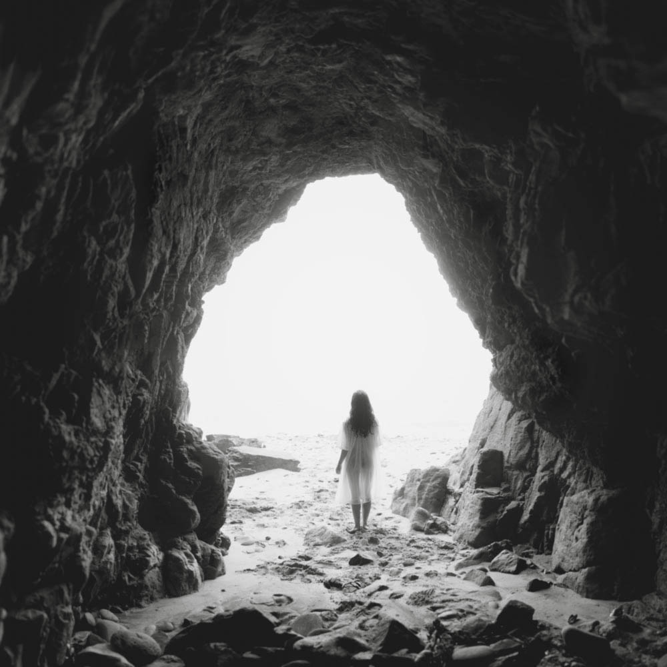
INDEX
MOCK UP
DESIGN

Slide 3
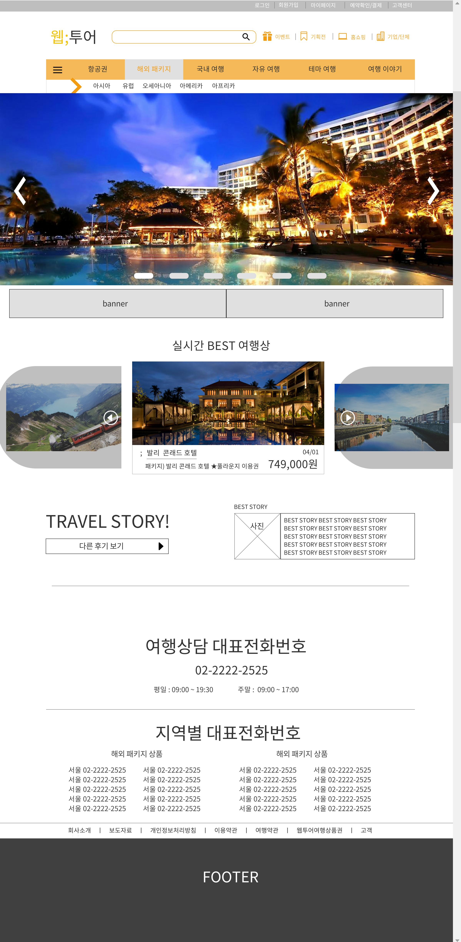
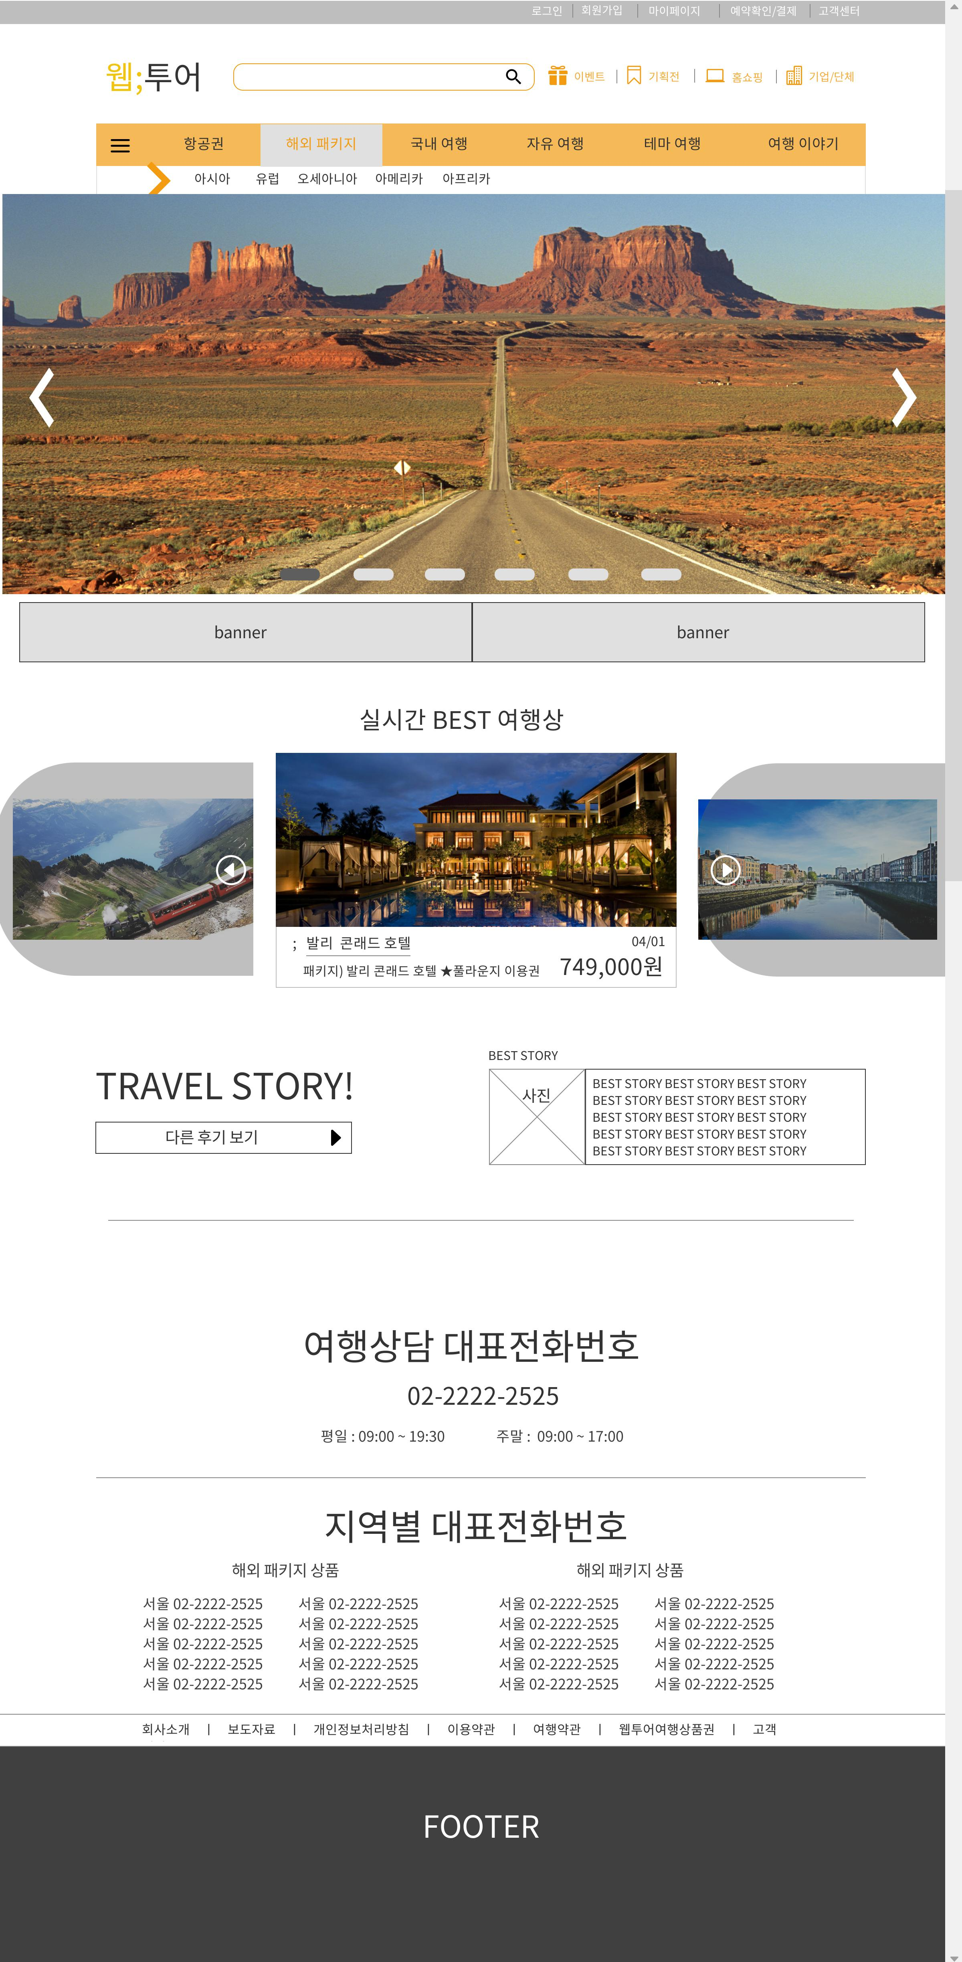
MOCK UP WEBTOUR SITE RENEWAL PROJECT
01
MAIN PAGE _ PC
WWW.WEBTOUR.COM/INDEX.ASP

Slide 4
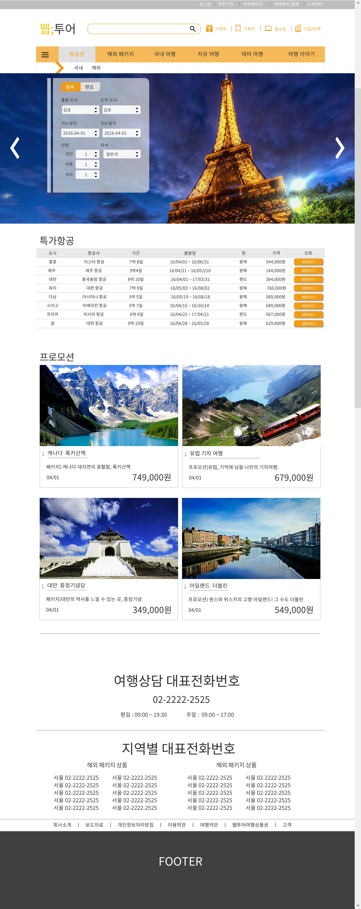
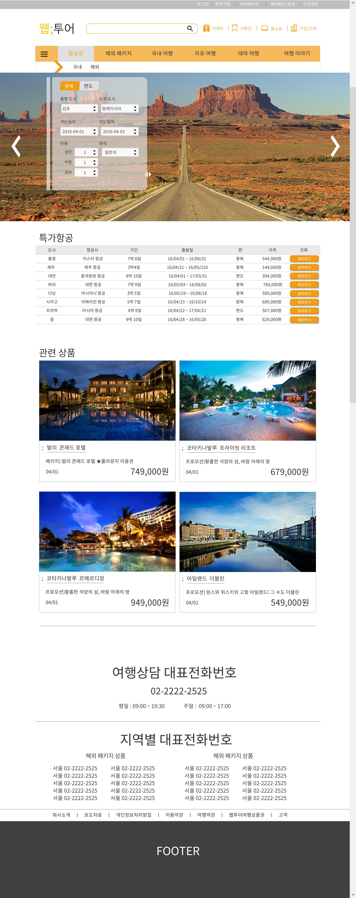
MOCK UP WEBTOUR SITE RENEWAL PROJECT
01
SUB PAGE _ PC
WWW.WEBTOUR.COM/INDEX.ASP

Slide 5
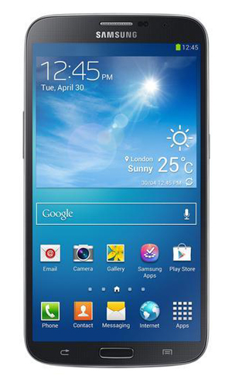
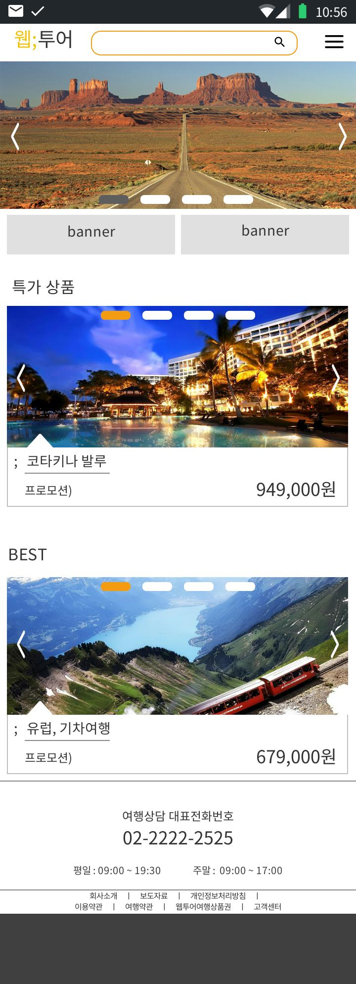
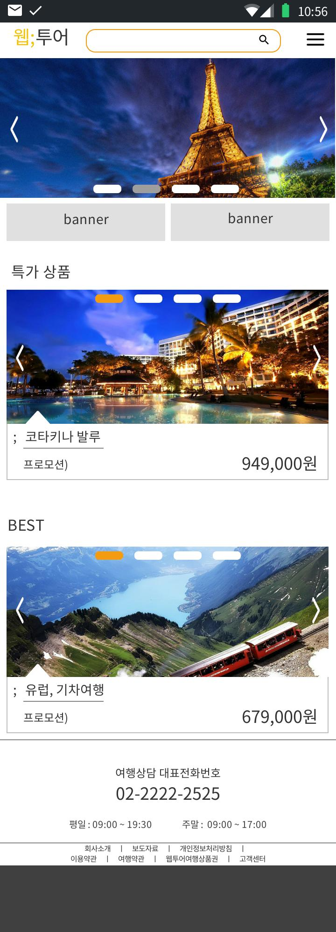
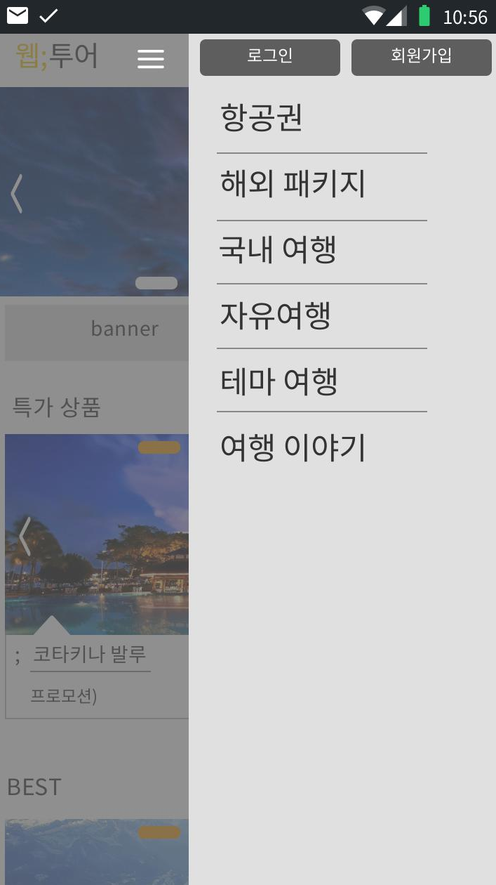
MOCK UP WEBTOUR SITE RENEWAL PROJECT
01
MAIN PAGE _ MOBILE
WWW.WEBTOUR.COM/INDEX.ASP

Slide 6
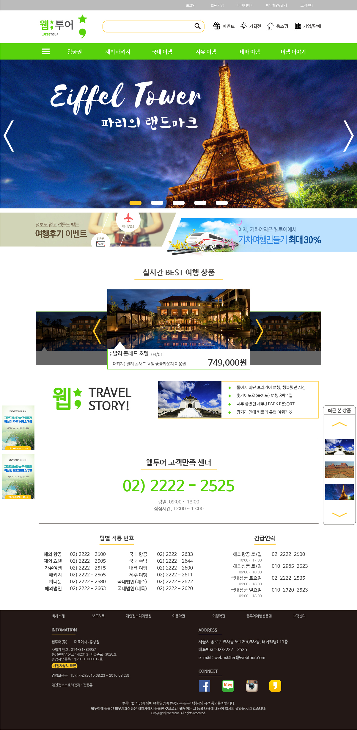
DESIGN WEBTOUR SITE RENEWAL PROJECT
02
MAIN PAGE _ PC
WWW.WEBTOUR.COM/INDEX.ASP

Slide 7
DESIGN WEBTOUR SITE RENEWAL PROJECT
02
HEADER
CONTENT
FOOTER
MAIN PAGE _ PC
WWW.WEBTOUR.COM/INDEX.ASP

Slide 8
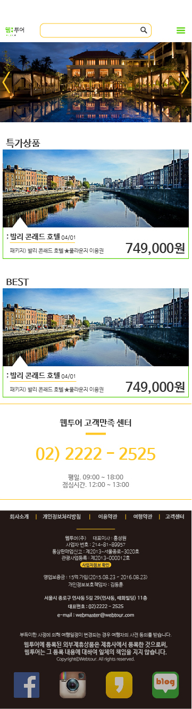
DESIGN WEBTOUR SITE RENEWAL PROJECT
02
HEADER
CONTENT
FOOTER
MAIN PAGE _ MOBILE
WWW.WEBTOUR.COM/INDEX.ASP

Slide 9
The end
Tourist team
여행가조

